Slide 1



Electronic structure of atoms. Basic rules of the quantum mechanical theory of atomic structure
Al-Farabi Kazakh National University
Faculty of Chemistry and Chemical technology
Department of General and Inorganic Chemistry
pHd Bakhadur askar

Slide 2
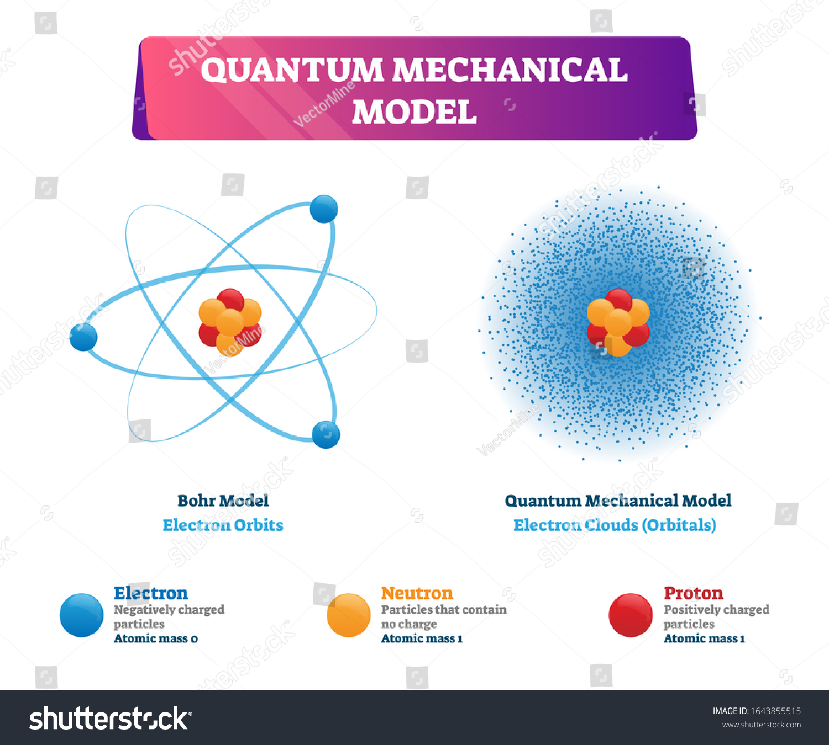
From Classical to Quantum Models
The classical planetary model of the atom, proposed by Rutherford and refined by Bohr, could not explain several key phenomena such as the stability of atoms and the discrete line spectra observed in atomic emission.
Quantum mechanics provided a new framework in which the behavior of electrons is described not by definite orbits but by wave functions (ψ) that represent probability distributions.
This approach fundamentally changed our understanding of matter at the atomic scale.
In quantum mechanics, we cannot determine both the exact position and momentum of an electron simultaneously (Heisenberg’s uncertainty principle).

Slide 3

Schrödinger Equation and Atomic Orbitals
The central equation of quantum mechanics is the time-independent Schrödinger equation:
where Ĥ - is the Hamiltonian operator representing the total energy of the system,
ψ - is the wave function,
E - is the energy of the electron.
Solving this equation for the hydrogen atom yields a set of quantized energy levels and corresponding atomic orbitals—regions in space where there is a high probability of finding an electron.
Each orbital is characterized by a unique set of quantum numbers.
$$\hat{H}ψ=Eψ$$

Slide 4
Quantum Numbers and Their Physical Meaning
Every electron in an atom is described by four quantum numbers:
Principal quantum number (n) — determines the size and energy of the orbital (n = 1, 2, 3, …).
Azimuthal (angular momentum) quantum number (l) — defines the shape of the orbital (l = 0 → s, 1 → p, 2 → d, 3 → f).
Magnetic quantum number (mₗ) — specifies the orientation of the orbital in space (−l ≤ mₗ ≤ +l).
Spin quantum number (mₛ) — describes the intrinsic spin of the electron, with possible values +½ or −½.
These quantum numbers form the foundation of the quantum mechanical description of atomic structure.

Slide 5
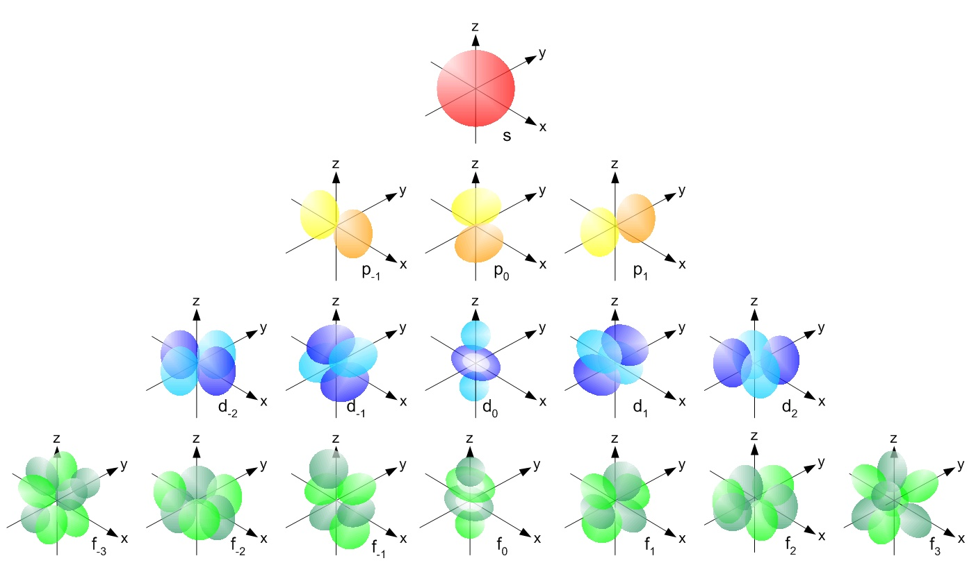
Shapes and Properties of Atomic Orbitals
Each type of orbital has a characteristic spatial distribution of electron density:
s-orbitals are spherical and centered around the nucleus.
p-orbitals have a dumbbell shape, oriented along the x, y, and z axes.
d- and f-orbitals exhibit more complex geometries, crucial for transition metals and lanthanides.
The probability of finding an electron decreases rapidly with increasing distance from the nucleus, but never becomes exactly zero.
Orbitals are not fixed paths; they represent electron probability distributions derived from ψ².

Slide 6
Principles Governing Electron Arrangement
Three fundamental principles determine how electrons occupy orbitals:
Aufbau Principle:
Electrons fill orbitals of lowest available energy first. The order follows the pattern:
1s → 2s → 2p → 3s → 3p → 4s → 3d → 4p → 5s → …
Pauli Exclusion Principle:
No two electrons in the same atom can have identical sets of four quantum numbers.
→ Each orbital can contain a maximum of two electrons with opposite spins.
Hund’s Rule:
In orbitals of equal energy (degenerate orbitals), electrons occupy separate orbitals singly before pairing up, to minimize electron-electron repulsion.

Slide 7
Electron Configurations and Periodic Properties
The arrangement of electrons among orbitals determines the chemical and physical properties of elements.
Electron configurations can be written in shorthand notation:
H: 1s¹
O: 1s² 2s² 2p⁴
Fe: [Ar] 4s² 3d⁶
Patterns in electron configurations explain the structure of the periodic table, including:
Periodic trends (ionization energy, electronegativity, atomic radius)
Chemical reactivity and bonding behavior
Thus, quantum mechanics provides a theoretical basis for periodicity in the elements.

Slide 8
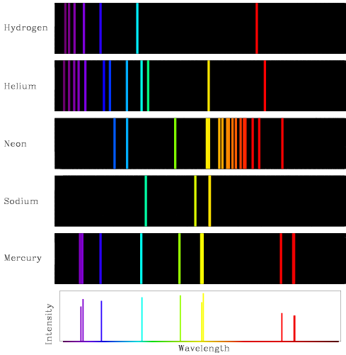

Atomic Spectra and Quantization of Energy
When an atom absorbs energy, an electron transitions from a lower to a higher energy level (excited state).
When it returns to a lower level, the energy difference is emitted as electromagnetic radiation (photon):
This explains the line spectra of atoms — distinct wavelengths corresponding to specific electronic transitions.
The hydrogen emission spectrum was one of the earliest confirmations of energy quantization and quantum theory.
$$E=hν=E_{2}−E_{1}$$

Slide 9
Conclusion
The quantum mechanical model replaces classical orbits with probabilistic orbitals.
Wave functions describe electron distributions and energies precisely.
The arrangement of electrons explains the chemical behavior and periodicity of elements.
Quantum mechanics not only unified atomic theory but also laid the groundwork for modern chemistry, spectroscopy, and materials science.

Slide 10

Questions?

